Slide 1
CMPS 270 Project
Connect 4 Game

Slide 2
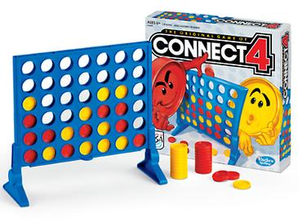
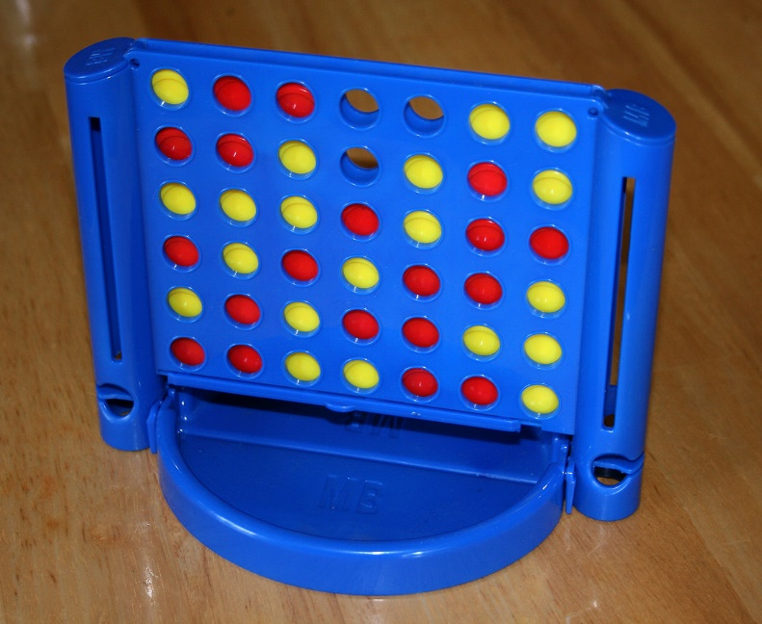
Introduction
Connect Four (also known as Connect 4, Four Up, Plot Four, Find Four, Captain's Mistress, Four in a Row, Drop Four) is a two-player connection board game, in which the players choose a color and then take turns dropping colored tokens into a seven-column, six-row vertically suspended grid. The pieces fall straight down, occupying the lowest available space within the column. The objective of the game is to be the first to form a horizontal, vertical, or diagonal line of four of one's own tokens. Connect Four is a solved game. The first player can always win by playing the right moves.

Slide 3
Game Rules
Welcome to CONNECT 4!
To begin with, the code will welcome you to the game and list all the rules that should be abided by throughout playing. The rules that will be given are the following:
1. The game board has seven columns and six rows.
2. There are 21 red and 21 yellow tokens.
3. One player plays with red tokens, and the other with yellow tokens.
4. The tokens are inserted at the top of a column, and they will fall and land on the ground (if the column was empty) or on top of a previously inserted token.
5. Red starts.
6. Red and yellow take turns.
7. One can only insert tokens in one of the seven columns.
8. One cannot insert a token into a full column.
9. A line consists of several tokens, either in vertical, horizontal, or diagonal form, which contains only tokens of the same color.
10. A player wins if they manage to form a line of four tokens of their color.
11. The game ends if one of the players wins.
12. There will be no ties. In case of a tie on the board, the player that took less overall time wins.

Slide 4
Specifications: Phase 1
Requires:
A valid column number (isFullColumn and wrongColumn functions)
A winner with no tie in the game (winning based on time if there was a tie) (checkWin and tie function)
Entering players’ names
Selecting first player (flipCoin function)
Checking valid inputs (Did we enter a string, integer, or character…?)
Displaying board game (draw function)
Updating Score (play function)
Effects:
- Playing a connect 4 game between 2 players and having a winner at the end

Slide 5
Testing: Phase 1
Part 1:
1) Each user must insert a name (run a game and see if names of players are displayed or not)
2) If users insert column range between 1-7 or not (test by inserting any number between 1 and 7 and check if it continues playing. Test by inserting numbers less than 1 and check if alert message is displayed. Test by inserting numbers greater than 7 and check if alert message is displayed).
3) If users insert letters/words instead of column number (enter strings, characters and check if alert message is displayed. Enter integers and check if the game continues).
4) If users are inserting in a full column (Test by playing a game and filling up any column with tokens without having a winner yet and then insert a token in the full column and check if an alert message is
Displayed. Test inserting a token in a column that is not full if the game will continue)
Part 2:
1) Coin system
Plotting on scratch
Check win vertically for all possibilities (play several games in which I put four tokens:
Column 1: row 1 till row 4 / row 2 till row 5 / row 3 till row 6
…
Column 7: …)
4) Check win horizontally for all possibilities (play several games in which I put four tokens:
row 1: column 1 till column 4 / column 2 till column 5 / column 3 till column 6 / column 4 till column 7
…
row 6: …)
5) Check win diagonally for all possibilities
6) Case of tie (take the user with least time as a winner)

Slide 6
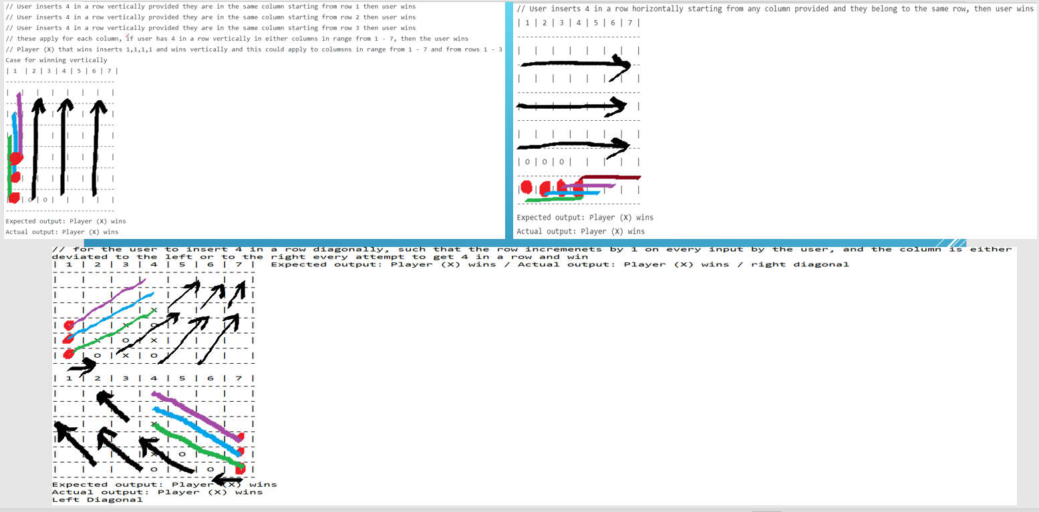

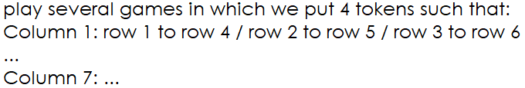
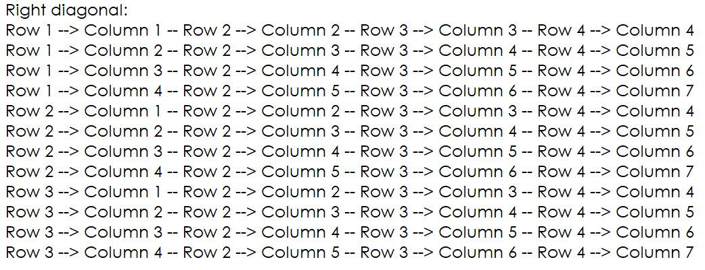
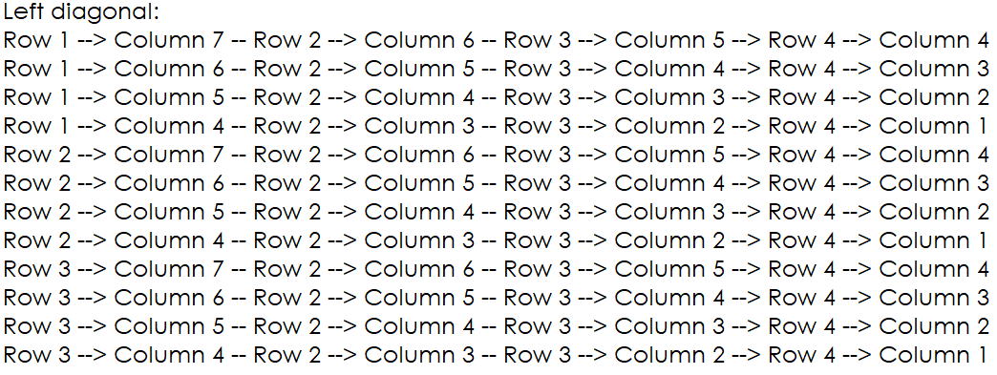

Slide 7
Bot Algorithm:
Monte Carlo
Description:
The implementation uses the Monte Carlo algorithm: for every potential move the bot can do, the bot plays a number of random games determined by us, sampling the number of games won and lost. Then the decision on what move to make is made based on the move that appears to have the best won/lost ratio with high probability to win. In other words, we will design a function that will return a column number representing a bot move. This function is based on the Monte Carlo algorithm and probabilities where it suggests a move among maximum of 7 possibilities (7 columns). For each move, we play random games and store the ratio between won and lost games. Finally, the move with the best ratio is returned. If there are no valid moves, -1 is returned

Slide 8
Bot Specifications
Requires:
Helper functions:
copy, checkEmpty, setValue, drop, getWinner, randomGame functions
2) Statistics and Probabilistic analysis
3) Randomness
4) Games of win and loss
5) Returning valid column number
Effects:
Bot returning column number with high probability of winning

Slide 9
Differences between:
Hard, Medium, Easy
What we did to differentiate between them is that for the easy version we increased the number of losses highly after performing the set of random games, this way we will be able to get a lower wins/losses ratio for each move (since losses are in the denominator), and thus the probability of winning for each move will be lower. In the medium version, we also increased the number of losses but in a way that is smaller than that of the easy version, and also same logic as the above will apply. (We though for a second that we have another approach to do this and maybe in a better way. Rather than increasing the number of losses at the end, we can decrease the number of winnings, so we decided to do a graph to see which approach is more better in making the bot weaker (is it the increase of losses or decrease of winnings?)
But lastly we have the hard version where we perform a lot of random games and let the moves have their probabilities based on these games without our interfering in changing the losses or the wins.

Slide 10
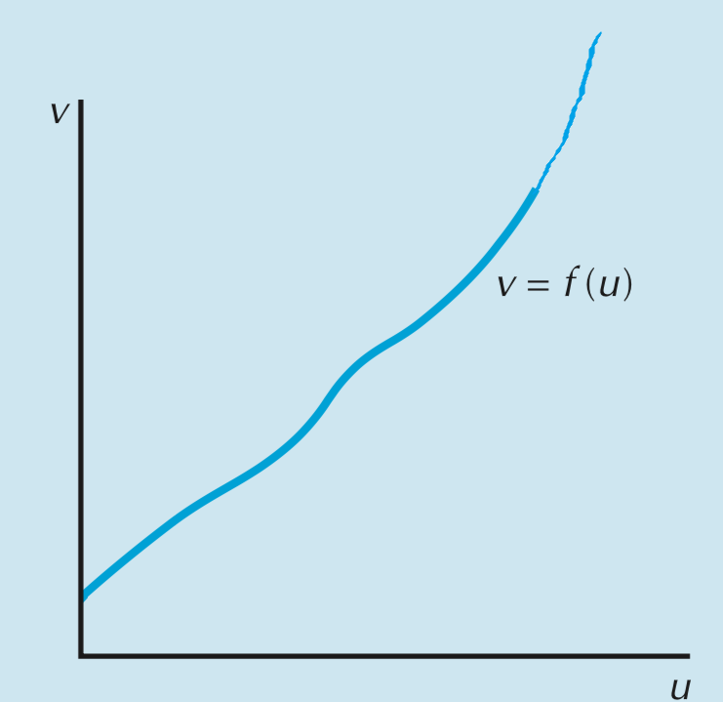
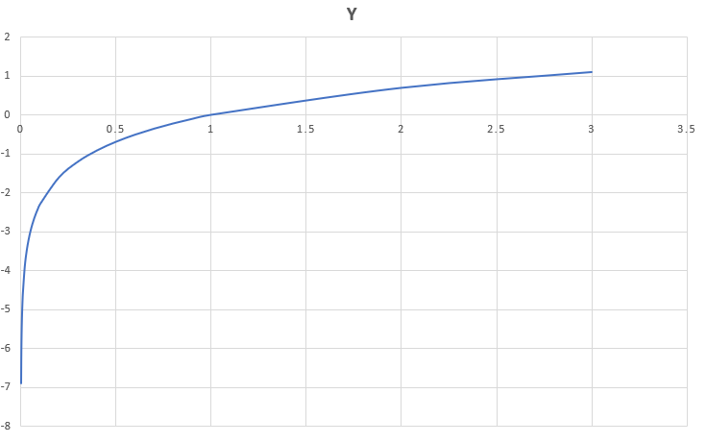
This function represents the rate by which the difficulty of the game becomes more easier. It shows approximately what we had plotted. This function corresponds to increasing the losses. It is kind of 2 degree polynomial function.
This function represents the rate by which the difficulty of the game becomes more easier. It shows approximately what we had plotted. This function corresponds to decreasing the losses. It is kind of log function with slow rate of increase.
As conclusion, we noticed that when increasing the number of losses, the game will be much more easier (2 degree polynomial function definitely has faster rate increase than log function) than decreasing the number of winnings noting that of course we have the same magnitude of increase and decrease

Slide 11
Bot Testing: Part 1
Check if our bot is player 1 or player 2 (by checking the first row in the board if it contains a token or not. We play 2 games: one with row 1 being empty (result should be player 1), and one with row 1 having a token (result should be player 2).
Check if a copy of array is created (copy Function: check by comparing every element of the copied array if they are the same as the original array. We can do that by looping across the columns and the rows and comparing).
Drop function: To test it, we tried to set a value of an empty position 3 times (the first one with value 1 and the second with the value 2), we then tried to set a value on a non-empty position and see what happens.
getWinner function has the same testing as checkWin function (the testing of checkWin is in previous slides) (basically, getWinner function has the same implementation as the checkWin function except that at the end of getWinner, we return the token of the winner)
Check how random games will be played (randomGame function will generate different scenarios of playing a game. To test it, we tested it by a large number of games and saw if there were random results like our bot winning, losing, or if we have a tie. If the results were all the same, then there is something wrong. If the results contained only 2 result possibilities (like winning and losing or winning and tying or losing and tying), then there is something wrong)
Check random games probabilistic results
Check Wins Losses ties
Check calculation
7) Check probability of winning for every move

Slide 12
Bot testing: Part 2
To test our bot, we played against 3 different algorithmic opponents of different strengths. First, our bot played against a very weak player that just selected moves at random. We expected the games to be evenly matched at first, but we were surprised by how quickly our bot was able to start winning. Next, our bot played against a stronger opponent using 50 random games sampling the wins and losses and becoming much trained and better than picking columns at random. The results were approximately an 80% win-rate by the end of the testing. Finally, we repeated the testing against an opponent which underwent 250 random games player. Here, the win rate for our bot decreased from 80% to 69.7%. We concluded that as the opponent or the player undergoes a lot of random games, it will become a much stronger and trained opponent having better probability of winning for the moves. So, what we thought about was that why not the number of random games be a very large number approaching infinity? In that case, we thought that the performance might be better. But then, we thought that probability is not definite or determinate, the results might change if the number of random games was really high, so we decided to search where we found out that we should not make it very high or the performance will be inefficient, so we made it relatively high that will have a good performance.

Slide 13
Complexity of the algorithm
The complexity of the Monte Carlo algorithm will highly depend on the number of random games that will be performed. Therefore, if the number of random games performed is n, then our function will run in O(n) where all the other operations will be considered constants and small relative to n.

Slide 14
Experience and Problems
Problem 1: loss most of the points in specifications part of phase 1
Solution: focus on specifications more, make them detailed with requirements and effects of each function
Problem 2: Changing from char 2d array to double integer array pointer as demanded by the professor (in phase 1, array implemented as char)
Solution: We tried different approaches without use, so we changed all of our functions into double integer array pointer)
Realizations:
Teamwork is important
Google is not always a saver
Sharing ideas is important
Skill of searching and keywords are important

Slide 15
Thank you!
Hope you Enjoyed!

